Slide 1
CSE308:COMPUTING PRACTICUM-IV
Unit 8: Implementing Advanced Storage Features
• Managing Layered Storage with Stratis
• Compressing and Deduplicating Storage with VDO
Outcome: Demonstrate compressing and deduplicating the storage and determine network -attached storage using the NFS protocol

Slide 2
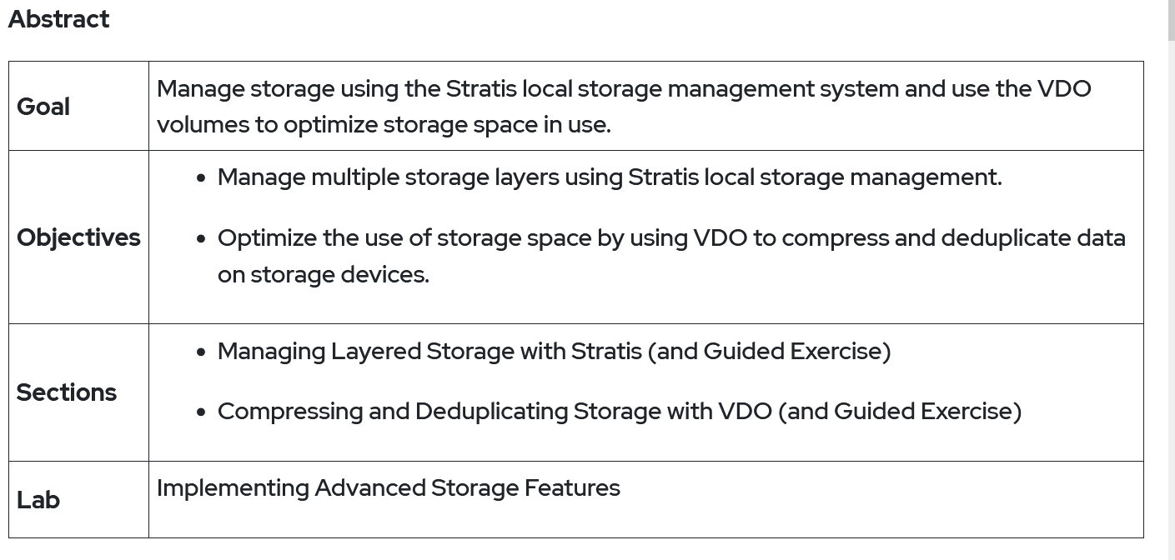

Slide 3
Managing Layered Storage with Stratis
To create a file system from a stratis pool?

Slide 4
Stratis
Stratis is a new local storage-management solution for Linux.
Stratis is designed to make it easier to perform initial configuration of storage, make changes to the storage configuration, and use advanced storage features.
It uses XFS file system

Slide 5
Components of a Stratis Volume
Blockdev – refers to the block devices such as disk partitions and minimum size required is 1GB
Pool-consists of one or more block devices. Size of the pool is sum of total of block devices.
Filesystem- there is no fix size of the filesystem. It grows its size as the size of the data grows.

Slide 6
Working with Stratis Storage
To manage file systems with the Stratis storage management solution,install the stratis-cli
and stratisd packages.
The stratis-cli package provides the stratis command, which sends reconfiguration
requests to the stratisd system daemon.
The stratisd package provides the stratisd service, which handles reconfiguration requests
and manages and monitors block devices, pools, and file systems that Stratis uses.

Slide 7
Step 1–install stratisd
Yum install stratisd stratis-cli

Slide 8
Step 2-Creating pool
stratis pool create pool1 /dev/sdb
Stratis pool list
Stratis add-data pool1 /dev/sdb1 (to extend the pool)

Slide 9
Step 3-Creating file systems from pools
stratis filesystem create pool1 fs1
stratis filesystem list (To check for the various file systems)
There is no need to format these filesystems.
Only you have to mount these filesystems.
Mkdir /fs1

Slide 10
Step 3-Creating file systems from pools(Continue)
lsblk --output=UUID /stratis/pool1/fs1
Vim /etc/fstab( then edit the file)
UUID /fs1 xfs defaults,x-systemd.requires=stratised.service 0 0
Save it and then check
Mount –a

Slide 11
Compressing and Deduplicating Storage with VDO
To create a vdo of named V1 of size 50GB and mount it at /VD1

Slide 12
VDO (Virtual Data Optimizer)
VDO is a kernel module that can save disk space and reduce replication bandwidth.
VDO sits on top of any block storage device and provides zero-block elimination, deduplication of redundant blocks, and data compression.

Slide 13
VDO (Virtual Data Optimizer
Zero-Block Elimination: In the initial phase, any blocks that consist entirely of zeros are identified and recorded only in metadata.
This can be understood with an example of sand mixed in a mug of water.
We use filter paper (zero-block elimination) to collect only sand particles (non-zero data blocks) out of water.
Similarly, VDO only allows blocks that contain something (data) other than all zeros to filter through to the next phase of processing.

Slide 14
VDO (Virtual Data Optimizer
2. Deduplication: In this second phase, the incoming data is processed to determined whether it is redundant data (data that has been written before) or not.
The redundancy of this data is checked through metadata maintained by the UDS (Universal Deduplication Service) kernel module delivered as part of VDO.
Any block of data that is found to be redundant will not be written out.
Instead, metadata will be updated to point to the original copy of the block already stored on media.

Slide 15
VDO (Virtual Data Optimizer
3. Compression: Once the initial zero elimination and deduplication phases are completed, LZ4 compression is applied to the individual data blocks.
The compressed data blocks are then packed together into fixed length (4 KB) blocks and stored on media.
Because a single physical block can contain many compressed blocks, this can also speed up the performance for reading data off storage.

Slide 16
Install VDO
Yum install vdo kmod-kvdo (Install th video with this command)
Vdo create –name VD1 –-device=/dev/sdb –vdologicalSize=50G(It will create vdo of 50G)
Vdo list (to check all vdos)
After creating vdo then format it
Mkfs.xfs /dev/mapper/VD1 (format it with xfs system)
Then mount it on a directory

Slide 17
Install VDO
Then mount it on a directory
Mkdir /appllleee (Create a directory)
Vim /etc/fstab and add entry like
/dev/mapper/VD1 /appllleee auto defaults,x.systemd.requires=vdo.service 0 0 (Save it )
Mount –a (No error everything is right)

Slide 18
How to update subscription manager repositories?
dnf repolist (to check whether subscribed or not )
subscription-manager register (It will ask for redhatuserid and password, after entering it will authenticate the same and leave you at the prompt)
subscription-manager list –available
subscription-manager attach --pool= (copy and paste here the pool)
subscription-manager list

